Slide 1
TITAN-X RACER SMART MULTI-TERRAIN WIRELESS RC VEHICLE
Department of Electronics and Communication Engineering
NEHRU INSTITUTE OF ENGINEERING AND TECHNOLOGY
(Autonomous)
An ISO 9001:2015 & 14001:2015 Certified Institution, Chennai
(Approved by AICTE, New Delhi, Recognized by UGC with 2(f) & 12(B)
Re-accredited by NAAC “A+”, NBA Accredited (UG Courses: AERO & CSE)
Nehru Gardens, Thirumalayampalayam, Coimbatore – 641 105

Slide 2

PROJECT MEMBERS
NAME REGISTER NO
DEVESH T - 721423106023
KARTHI A - 721423106048
KISHORE R - 721423106051
MAHESWARAN S - 721423106054
GUIDED BY,
Dr. M.A. RAJA
ASSISTANT PROFESSOR / ECE
Department of Electronics and Communication Engineering

Slide 3

  This project is titled as TITAN X RACER Smart Multi-Terrain Wireless RC Vehicle. The system is designed to operate efficiently on different terrains using wireless joystick control. It integrates DC motors, ESC, servo motor, and lithium-ion battery to provide smooth movement, better stability, improved control accuracy, and enhanced operational performance.
Department of Electronics and Communication Engineering

Slide 4

To design and develop a smart wireless RC vehicle capable of operating on multiple terrains efficiently.
To improve vehicle control accuracy and movement using a joystick-based wireless control system.
To enhance system performance, stability, and power efficiency compared to conventional RC vehicles.
Department of Electronics and Communication Engineering

Slide 5

This project is titled as TITAN X RACER Smart Multi-Terrain Wireless RC Vehicle designed to operate efficiently on different terrains such as sand, grass, and rough surfaces using wireless joystick control.
The system uses DC motor, ESC, servo motor, battery, receiver, and joystick controller for smooth movement and control.
The main objective of this project is to improve the performance, stability, and control accuracy of conventional RC vehicles.
Department of Electronics and Communication Engineering

Slide 6

Wireless joystick control provides smooth directional movement and quick response.
The system is designed with efficient power management for longer operating time.
Department of Electronics and Communication Engineering

Slide 7

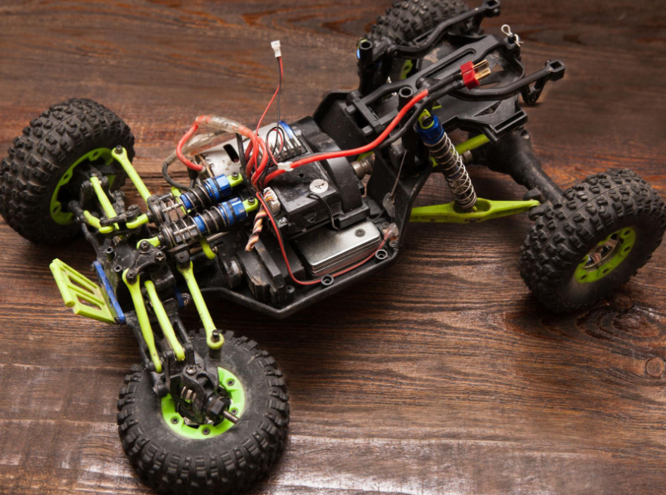
Existing RC vehicles use simple remote control systems with basic movement functions. These vehicles can move only on smooth surfaces and have limited speed and steering control.
Traditional RC cars have low stability and poor terrain adaptability. They face difficulty while operating on rough roads, sand, and grass surfaces.
Department of Electronics and Communication Engineering

Slide 8

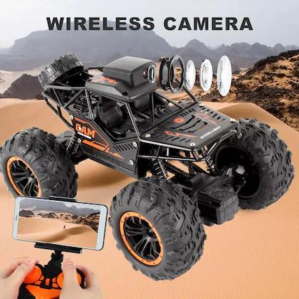
The proposed system uses wireless joystick control for smooth vehicle movement and accurate steering.
The system provides better stability, improved performance, and efficient power management compared to existing RC vehicles.
Department of Electronics and Communication Engineering

Slide 9

  Existing RC vehicles provide only basic speed and steering control, which reduces movement accuracy and smooth operation during driving.
  Traditional RC systems cannot operate efficiently on rough terrains such as sand, grass, and uneven surfaces due to low stability and poor terrain adaptability.
  Inefficient power management, limited wireless range, and signal delay reduce the overall performance and reliability of conventional RC vehicle systems.
Department of Electronics and Communication Engineering

Slide 10

Existing RC vehicles have poor control and steering, which affects smooth vehicle movement.
Traditional RC cars cannot move properly on sand, grass, and rough surfaces
Low battery efficiency and signal delay reduce the overall performance of the system.
Department of Electronics and Communication Engineering

Slide 11
Existing systems have low stability while moving on uneven roads.
Basic remote control systems provide less movement accuracy.
Conventional RC vehicles have limited operating range and reduced response speed.
Department of Electronics and Communication Engineering

Slide 12

The proposed system uses wireless joystick control for smooth and accurate vehicle movement.
The vehicle is designed to operate efficiently on multiple terrains such as sand, grass, and rough roads.
DC motor and Electronic Speed Controller (ESC) are used to achieve better speed control and performance.
Department of Electronics and Communication Engineering

Slide 13
A servo motor is used for precise steering and directional movement of the vehicle.
The lithium-ion battery provides efficient power management and longer operating time.
The integrated system improves stability, control accuracy, responsiveness, and overall vehicle performance.
Department of Electronics and Communication Engineering

Slide 14

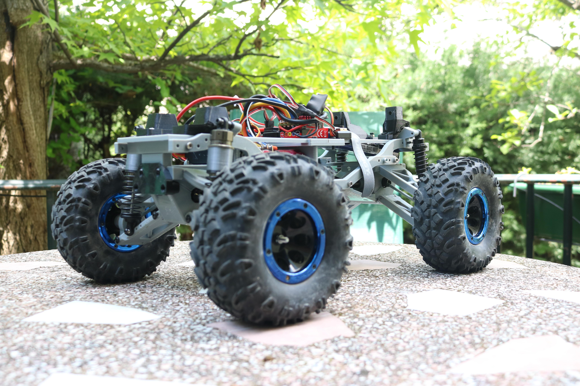
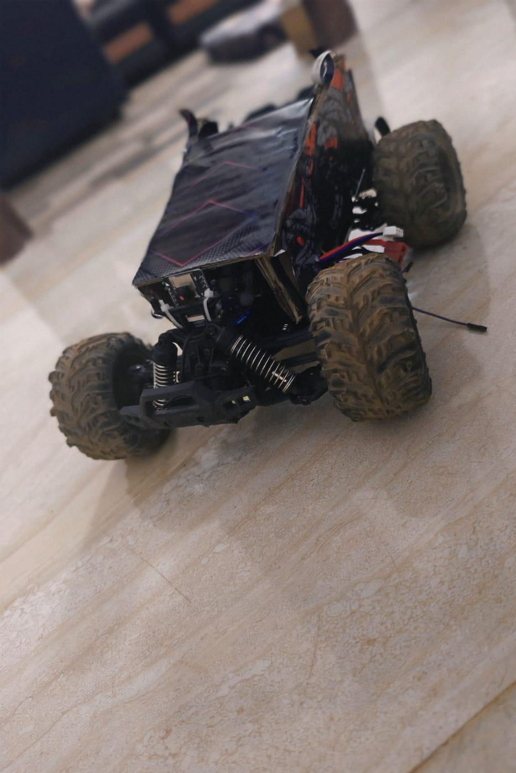
Department of Electronics and Communication Engineering

Slide 15

◆ Smooth wireless control with improved vehicle performance.
◆ Improved stability and power efficiency.
◆ Efficient operation on sand, grass, and rough surfaces.
Department of Electronics and Communication Engineering

Slide 16

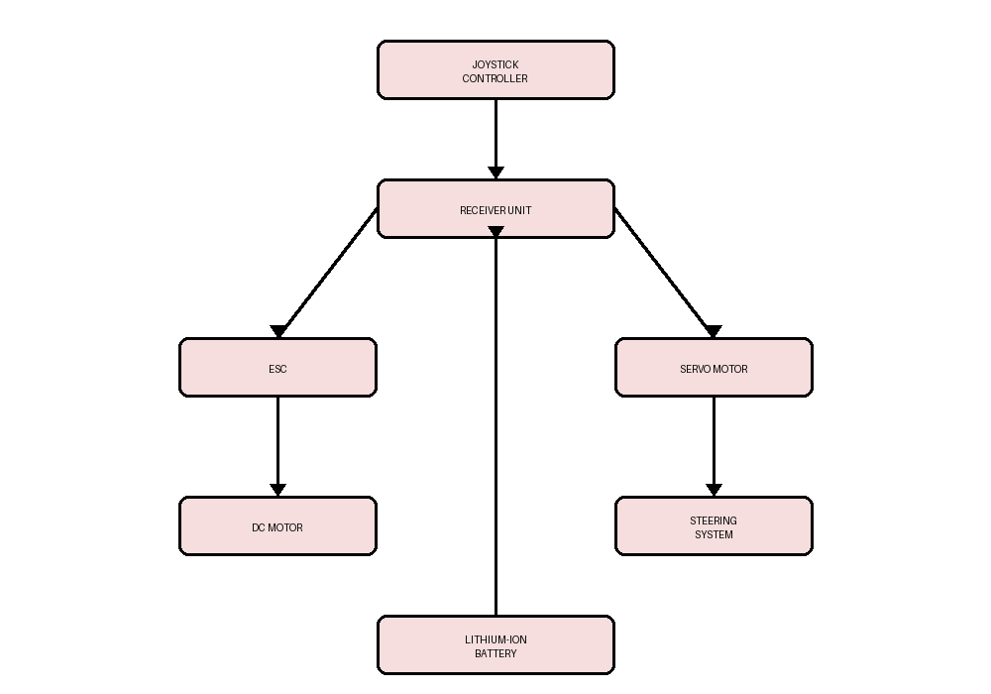
Department of Electronics and Communication Engineering

Slide 17

DC Motor
Electronic Speed Controller (ESC)
Servo Motor
Lithium-ion Battery
Receiver Unit
Joystick Controller
Chassis and Wheels
Wiring and Connectors
Department of Electronics and Communication Engineering

Slide 18

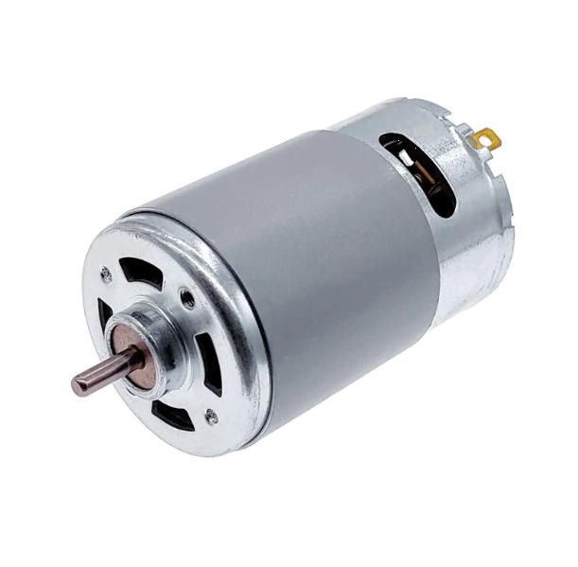
DC Motor :
Used for vehicle movement and speed generation.
Provides high torque for multi-terrain operation.
Supports smooth forward and reverse movement.
Operates efficiently with ESC control mechanism.
Improves vehicle performance and driving stability.
Department of Electronics and Communication Engineering

Slide 19
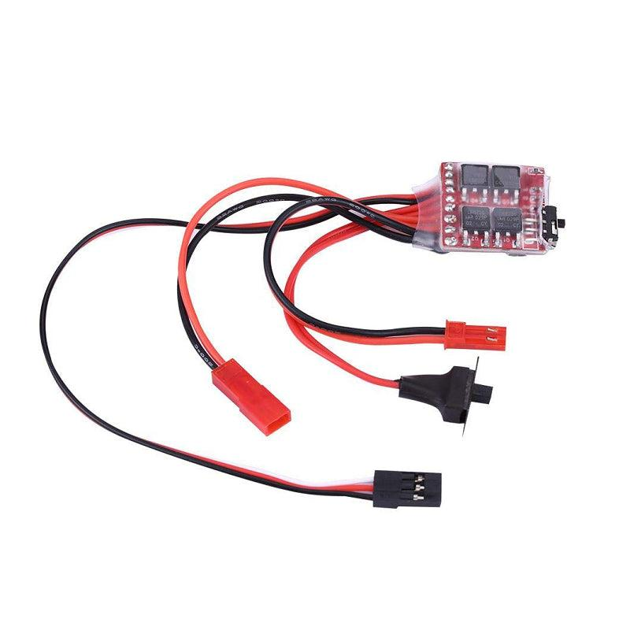
ELECTRONIC SPEED CONTROLLER (ESC):
Controls the speed of the DC motor.
Provides smooth acceleration and deceleration.
Receives control signals from the receiver unit.
Improves motor efficiency and performance.
Protects the motor from overload conditions.
Department of Electronics and Communication Engineering

Slide 20
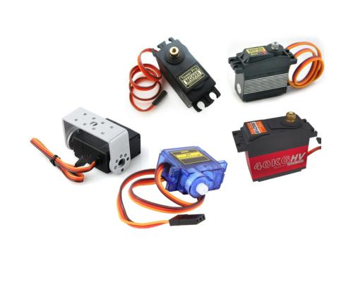
Servo Motor:
Used for steering and directional control.
Provides accurate left and right movement.
Operates based on receiver control signals.
Improves steering precision and stability.
Supports smooth vehicle navigation.
Department of Electronics and Communication Engineering

Slide 21
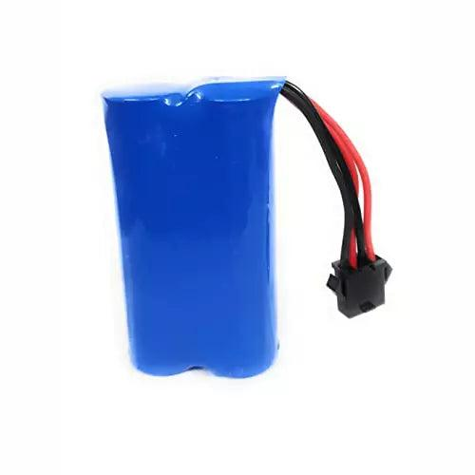
Lithium-ion Battery :
Provides power supply to the entire system.
Offers longer operating duration and efficiency.
Supports stable power distribution to components.
Rechargeable and suitable for wireless applications.
Reduces power loss during operation.
Department of Electronics and Communication Engineering

Slide 22

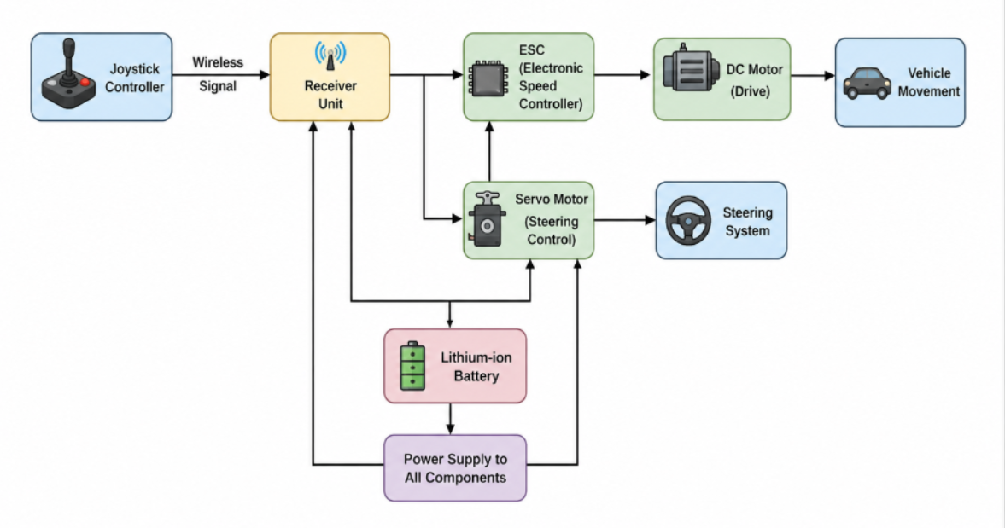
Department of Electronics and Communication Engineering

Slide 23

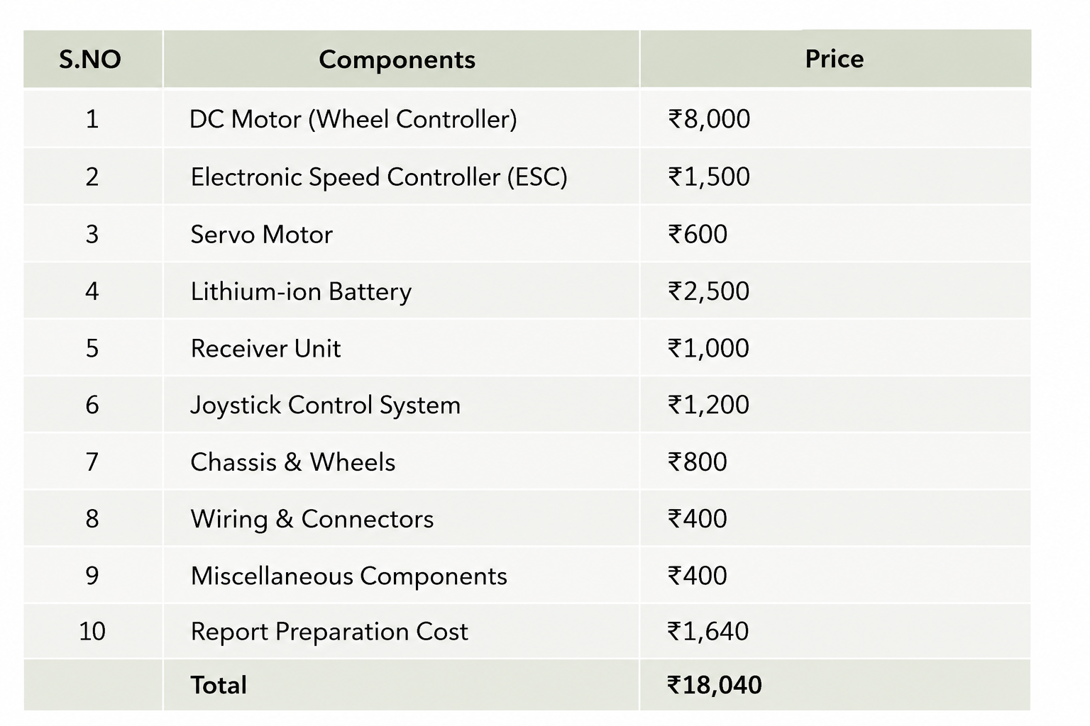
Department of Electronics and Communication Engineering

Slide 24

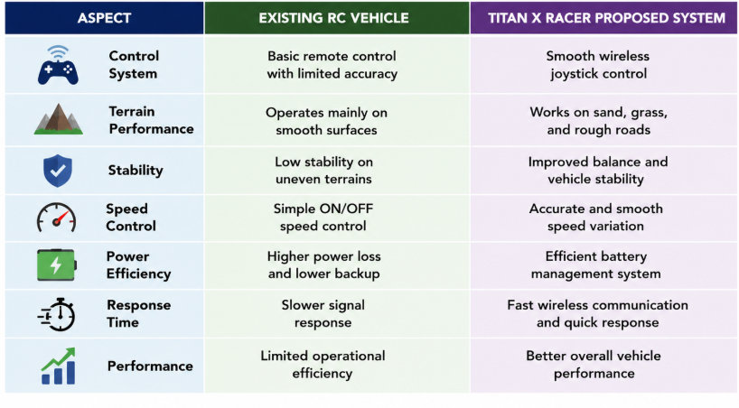
COMPARATIVE ANALYSIS WITH EXISTING SYSTEMS
Department of Electronics and Communication Engineering

Slide 25

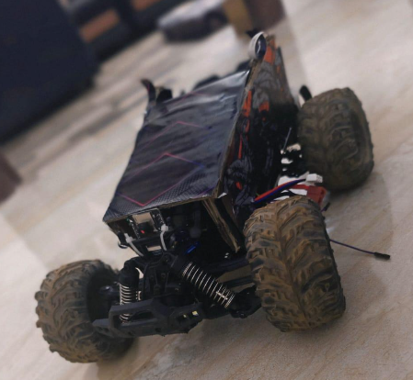
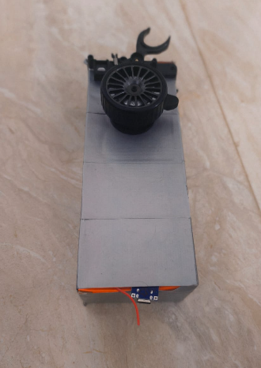
Department of Electronics and Communication Engineering

Slide 26

CONCLUSION :
The project successfully provides smooth wireless control and accurate vehicle movement.
The vehicle can operate efficiently on sand, grass, and rough surfaces.
The system improves stability, speed control, and overall vehicle performance.
Department of Electronics and Communication Engineering

Slide 27

P. Sharma and R. Kumar, “Design and Development of Wireless Multi-Terrain RC Vehicle Systems,” International Journal of Engineering Research and Technology (IJERT), 2023.
S. Rajesh and M. Karthik, “Implementation of Joystick Controlled Smart RC Vehicle using ESP32,” International Research Journal of Modernization in Engineering Technology and Science (IRJMETS), 2024.
A. Verma and K. Singh, “Performance Analysis of Wireless Remote-Controlled Vehicle using ESC and Servo Motor,” International Journal of Innovative Science and Research Technology (IJISRT), 2022.
Department of Electronics and Communication Engineering

Slide 28

Thank You
Department of Electronics and Communication Engineering

